Slide 1
Parkinson Disease Classification
Utilizing Ensemble and Quantum Neural Network Approaches
Under Guidance of Dr Mukesh Kumar

Slide 2
Presented by
1. Ayush Kumar - 2105955
2. Aditya Srivastava - 21051111
3. Dhrubojyoti Mahato - 21051561
4. Harshita Anmol - 21051565
5. Abhishek Kumar - 21051620
6. Soham Sanyal - 21051690

Slide 3
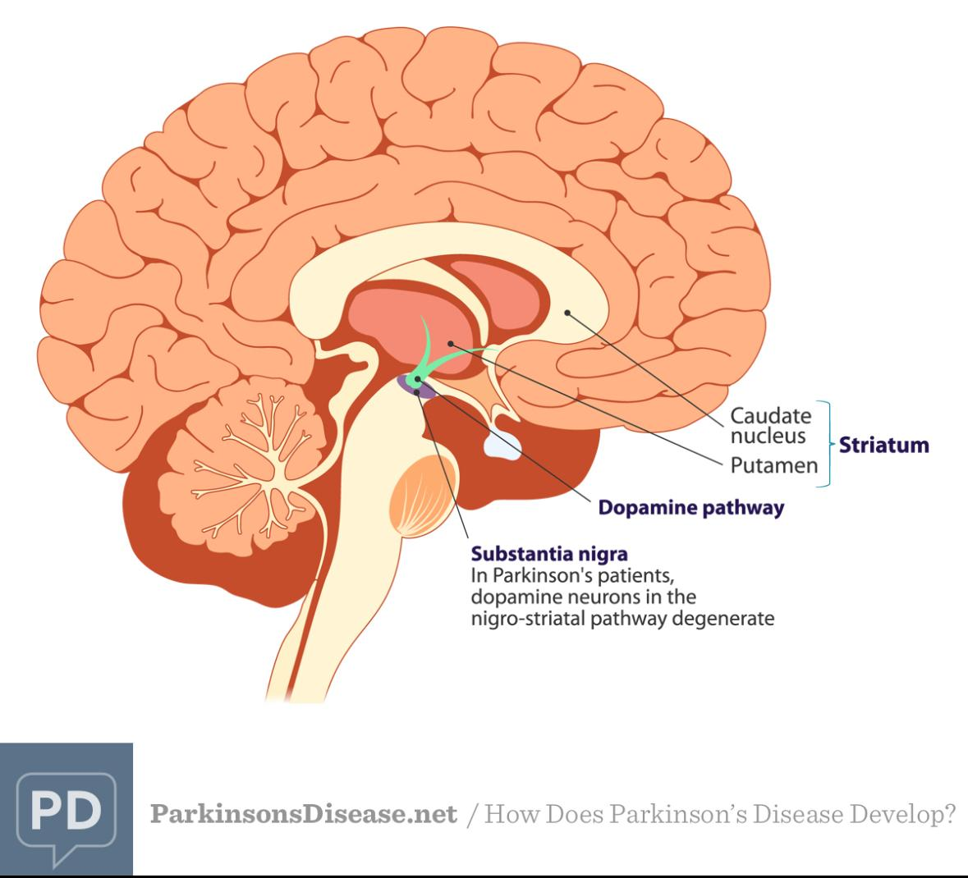
Introduction
This presentation explores the classification of Parkinson's disease using various machine learning approaches, including classical machine learning models, ensemble techniques and Quantum Convolutional Neural Networks.

Slide 4
01
Classification Techniques

Slide 5
Logistic Regression
Purpose: Predicts the probability that a person has Parkinson’s (Yes/No).
How it works: Uses a sigmoid function to map feature values to a probability between 0 and 1.
Why it fits: It's a simple and effective algorithm for binary classification tasks.

Slide 6
Support Vector Machine
How it works: It maximizes the margin between classes, working well in high-dimensional space.
Purpose: Finds the optimal boundary (hyperplane) that separates the two classes.
Why it fits: Effective when there’s a clear margin of separation.

Slide 7
K-Nearest Neighbours(KNN)
Purpose: Classifies a sample based on the majority class among its closest neighbors.
How it works: For a new voice sample, it checks how the closest k samples are labeled.
Why it fits: It's simple, but sensitive to noise and the choice of k.

Slide 8
Gaussian Naive Bayes
Purpose: Predicts the class based on probability, assuming features follow a normal distribution and are independent.
How it works: Applies Bayes' theorem with the assumption of Gaussian distribution.
Why it fits: Very fast and performs well with small datasets, even if the assumptions aren’t strictly met.

Slide 9
02
Ensemble Methods

Slide 10
Introduction to Ensemble Methods
✅ Definition: -Ensemble methods combine multiple machine learning models to improve overall performance.
🎯 Goal: -Increase accuracy, reduce overfitting, and handle complex patterns in data.
🧠 Why Use Them?
-Single models may miss patterns or overfit.
-Ensembles use diversity to build more robust models.

Slide 11
Boosting Methods used
1. Gradient Boosting Classifier
Builds models sequentially by minimizing prediction errors
Each new tree corrects the mistakes of the previous ones
Slower than XGBoost, but interpretable and powerful
2. XGBoost (Extreme Gradient Boosting)
Advanced version of gradient boosting with regularization
Fast, efficient, and handles missing values well
Often performs best in structured data problems
3. AdaBoost (Adaptive Boosting)
Assigns higher weights to wrongly classified instances
Focuses more on difficult cases as it trains
Works well with simple models like decision stumps
variance.

Slide 12
Why we used them?
Handle non-linear features and complex relationships in voice data.
Helped us achieve high accuracy compared to single models.
Performance & Benefits
📈 Improved Accuracy: Both ensemble models showed strong performance in cross-validation.
🛡️ Better Generalization: They avoid overfitting better than single classifiers.
⚕️ Reliable Medical Prediction: Useful for real-world applications like Parkinson’s detection using voice.

Slide 13
03
Quantum Convolutional Neural Network

Slide 14
Introduction to QCNN
QCNN is the quantum counterpart of classical CNNs used in deep learning.
Instead of using neurons and layers, QCNN uses quantum gates and circuits.
It can process quantum data or classical data encoded into quantum states.
QCNNs can find patterns in data using quantum entanglement and superposition.

Slide 15
Benefits:
May offer advantages in accuracy and computational power as quantum hardware improves.
A step toward quantum machine learning in healthcare applications.

Slide 16
Conclusion
In this project, we explored multiple approaches to predict Parkinson’s Disease using both classical and quantum machine learning models. We first applied traditional ML classifiers like Logistic Regression, Random Forest, and SVM to build strong baselines. Then, we enhanced prediction performance using ensemble methods such as Voting, Bagging, and Boosting. Finally, we implemented a Quantum Convolutional Neural Network (QCNN) to demonstrate the potential of quantum machine learning in healthcare. This project highlights how combining classical and quantum techniques can improve disease diagnosis and open doors to more advanced, efficient medical solutions in the future.

Slide 17
Thank you!

